Slide 1






Software Maintenance and Configuration Management

Slide 2
Types of Software Maintenance
▪
In a software lifetime, type of maintenance may vary based on its
nature
▪
It
may
be
just
a routine
maintenance
tasks
as some
bug
discovered by some user or it may be a large event in itself
on maintenance size or nature
based
▪
Following
are
some
types
of
maintenance
based
on
their
characteristics
•
•
•
•
Corrective Maintenance
Adaptive Maintenance Perfective Maintenance Preventive Maintenance

Slide 3


Types
of
Software Maintenance Cont.
Corrective Maintenance
•
This
includes
modifications
done
in
order
to fix
problems
Corrective
•
maintenance
deals
with
the
repair
of
defects found in day-to-day system functions
Adaptive Maintenance
•
This
includes
modifications
applied
to
keep
the
software product up-to-date
•
Adaptive
maintenance
is the
implementation
of
changes in a part of the system, which has been
affected by a change that occurred in some other part of the system

Slide 4
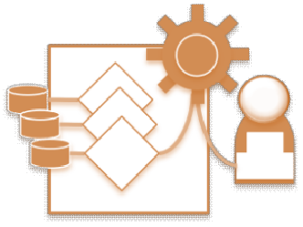

Types
of Software Maintenance Cont.
Perfective Maintenance
•
This includes modifications done in order to keep the
software usable over long period of time
It includes new features, new user requirements for
•
refining
the
software
and
improve
its
reliability
and
performance.
This includes changing the functionalities of as per the user’s changing needs
•
Preventive Maintenance
•
•
Modifications to prevent future problems of software
It aims to attend problems, which are not significant at this moment but may cause serious issues in future
It comprises documentation updating, code optimization
and code restructuring.
•

Slide 5

Re-Engineering
▪
When we need to update the software to keep it to the current
market, without impacting its functionality, it is called software
re-engineering
▪
It
is a
process
where
the
design of software
is changed and
programs are re-written
Legacy software cannot keep tuning with the latest technology available in the market
▪
•
For example, initially UNIX was developed in assembly language.
When language C came into existence, UNIX was re-engineered in
C, because working in assembly language was difficult.
▪
Other than this, sometimes programmers notice that few parts of
software need more maintenance than others and they also need re-engineering

Slide 6
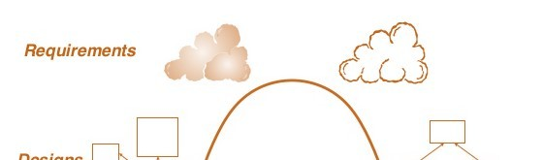
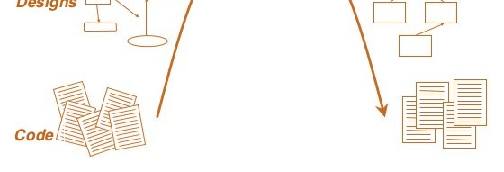
Re-Engineering
Cont.
Forward
Engineering
Reverse Engineering

Slide 7
Re-Engineering
Cont.
Program
Restructuring
Change
Obtain
specifications of existing
Get re-
engineered software
program
and/or data structure
software
Reverse
Engineering
developed
Forward
Engineering

Slide 8
Re-Engineering Process
▪
Decide what to re-engineer.
•
Is it whole software or a part of it?
▪
Perform Reverse Engineering, in order to
existing software
Restructure Program if required
obtain specifications of
▪
•
For example, changing function-oriented programs into object-
oriented programs and re-structure data as required
▪
Apply
Forward
engineering
concepts
in
order
to
get
re-
engineered software

Slide 9

Reverse Engineering
▪
Reverse engineering can extract design information from source
code
The abstraction level of a reverse engineering process refers to the sophistication of the design information that can be extracted from source code
Ideally, the abstraction level should be as high as possible
The reverse engineering process should be capable of
▪
▪
▪
•
Deriving
procedural
design
representations
(a
low-level
abstraction)
Program and data structure
level of abstraction)
•
information (a
somewhat
higher
•
Object
models,
data
flow
models
(a
relatively
high
level
of
abstraction)
Entity relationship models (a high level of abstraction).
•

Slide 10

Reverse Engineering Cont.
▪
As the abstraction level increases, information will allow easier
understanding of the program
▪
Interactivity refers
to
the degree to
which
the
human
is
“integrated” with automated tools to create an effective reverse
engineering process
In most cases, as the abstraction level increases, interactivity must increase
▪
▪
The directionality of the reverse engineering process is one-way,
all information extracted from the source code is provided to the
software engineer

Slide 11
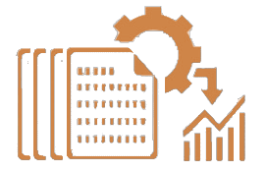
Forward engineering
▪
Forward engineering is a process of obtaining desired software
from
the specifications,
which
were
brought
by
reverse
engineering
Forward engineering is same as software with only one difference it is carried out engineering
In most cases, forward engineering does
▪
engineering
always after
process
reverse
▪
not simply create a
modern equivalent of an older program
Rather, new user and technology requirements are integrated
into the reengineering effort
The redeveloped program extends the capabilities of the older application
▪
▪

Slide 12

Software Configuration Management
The SCM (Software Configuration Management) is a set of activities
that
have
been
developed to manage
change
throughout
the
software life cycle
Purpose:
Systematically control changes to the configuration and maintain the integrity
and traceability of the configuration throughout the system’s life cycle
Four primary objectives
•
•
•
•
To identify all items that collectively define the software configuration
To manage changes to one or more of these items
To facilitate the construction of different versions of an application
To ensure that software quality is maintained as the configuration evolves over time

Slide 13
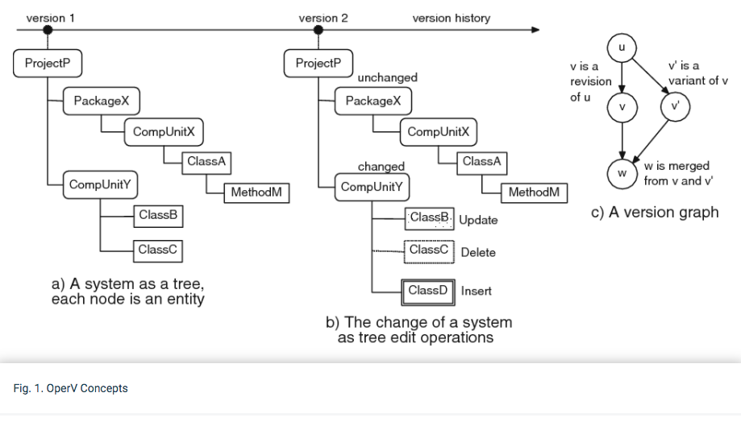
Base Line

Slide 14
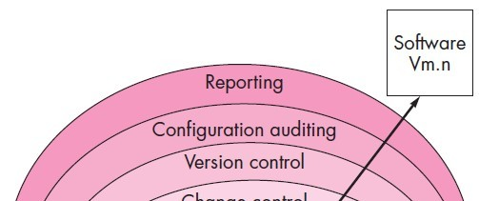
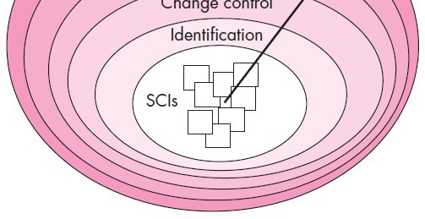

Layers of SCM Process

Slide 15

The SCM Process
▪
▪
Referring to the figure, SCM tasks can viewed as concentric layers
SCIs (Software Configuration Item) flow outward through these layers throughout their useful life
As an SCI moves through a layer, the actions implied by each SCM
task may or may not be applicable
▪
•
•
For example, when a new SCI is created, it must be identified.
However, if no changes are requested for the SCI, the change control layer does not apply
▪
The SCI is assigned to a specific version of the software (version
control mechanisms come into play)
▪
A
record of the SCI (its name,
creation
date,
version,
etc.) is
maintained for configuration auditing purposes

Slide 16

Change Control
▪
Change control is a procedural activity that ensures quality and
consistency as changes are made to a configuration object
A change request is submitted to a configuration control authority, which is usually a change control board (CCB).
▪
•
The
request
is
evaluated
for
technical
merit,
potential
side
effects, overall impact on other
configuration objects and system
functions,
resources
and
projected
cost
in
terms
of money, time
and
▪
An engineering change
change request
order (ECO)
is issued for each approved
•
Describes the change
the criteria for review
to be made,
and audit
the constraints to follow and

Slide 17

Change Control Cont.
▪
The Base lined SCI is obtained from the SCM repository
•
Access
control
governs
which software
engineers
have
the
authority to access and modify a particular configuration object
Synchronization control helps to ensure that parallel changes
performed by two different people don't overwrite one another.
•

Slide 18
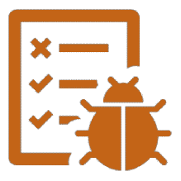
Version Control
▪
Version control is a set of procedures and tools for managing the
creation and use of multiple occurrences of objects in the SCM
repository
Version Control Capabilities
▪
•
•
An SCM repository that stores all relevant configuration objects
A version management capability that stores all versions of a configuration object
•
A make facility that enables the software engineer to collect all
relevant configuration objects and construct a specific version of the software
Issues or bug tracking capability that enables the team to record and track the status of all outstanding issues associated with each configuration object
•

Slide 19



Version Control cont.
▪
The SCM repository maintains a change set
•
Serves
as
a
collection
of
all changes
made
to a
baseline
configuration
Used to create a specific version of the software
Captures all changes to all files in the configuration along with the reason for changes and details of who made the changes and when
•
•
Few version control systems

Slide 20
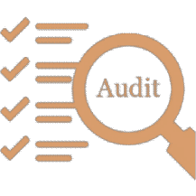
Configuration Audit
▪
Configuration auditing is an SQA activity that helps to ensure that
quality is maintained as changes are made.
It complements the formal technical review and is conducted by the SQA group
▪
▪
It
•
addresses the following questions
Has a formal technical review been conducted to assess technical
correctness?
•
Has
the
software
process been
followed
and
have
software
engineering standards been properly applied?
Has the change been "highlighted" and "documented" in the SCI? Have the change data and change author been specified? Do the attributes of the configuration object reflect the change?
•

Slide 21

Configuration Audit Cont.
•
Have SCM procedures for noting the change, recording it and
reporting it been followed?
Have all related SCIs been properly updated?
configuration audit ensures that
•
A
•
▪
The
correct
SCIs
(by
version)
have
been incorporated
into
a
specific build
That all documentation is up-to-date and consistent with the
•
version that has been built

Slide 22
BUSINESS PROCESS REENGINEERING
Business process reengineering (BPR) extends far beyond the scope of information technologies and software engineering.
Definition: “the search for, and the implementation of, radical change in business process to achieve breakthrough results.”
Business Processes: A business process is “a set of logically related tasks performed to achieve a defined business outcome”.
Every business process has a defined customer—a person or group that receives the outcome (e.g., an idea, a report, a design, a service, a product).

Slide 23
In addition, business processes cross organizational boundaries. They require that different organizational groups participate in the “logically related tasks” that define the process.
Every system is actually a hierarchy of subsystems. A business is no exception.
The overall business is segmented in the following manner:
The business -> business systems -> business processes -> business subprocesses.
Each business system (also called business function) is composed of one or more business processes, and each business process is defined by a set of subprocesses.
BPR can be applied at any level of the hierarchy, but as the scope of BPR broadens the risks associated with BPR grow dramatically.

Slide 24
A BPR Model
Like most engineering activities, business process reengineering is iterative.
Business goals and the processes that achieve them must be adapted to a changing business environment.
For this reason, there is no start and end to BPR—it is an evolutionary process.
The model defines following six activities:
Business definition. Business goals are identified within the context of four key drivers:
cost reduction,
time reduction,
quality improvement
personnel development and empowerment.
Goals may be defined at the business level or for a specific component of the business.

Slide 25
Process identification. Processes that are critical to achieving the goals defined in the business definition are identified.
They may then be ranked by
importance
by need for change
or in any other way that is appropriate for the reengineering activity.
Process evaluation. The existing process is thoroughly analyzed and measured. Process tasks are identified; the costs and time consumed by process tasks are noted; and quality/performance problems are isolated.

Slide 26
Process specification and design. Based on information obtained during the first three BPR activities, use cases are prepared for each process that is to be redesigned. Within the context of BPR, use cases identify a scenario that delivers some outcome to a customer. With the use case as the specification of the process, a new set of tasks are designed for the process.
Prototyping. A redesigned business process must be prototyped before it is fully integrated into the business. This activity “tests” the process so that refinements can be made.
Refinement and instantiation. Based on feedback from the prototype, the business process is refined and then instantiated within a business system.

